Slide 1
EXPERIMENT 18
SIMULATING X,Y,Z COMPANY NETWORK DESIGN
ALGORITHM :
Step 1:Take one router and one peer
Step 2: take two multiplayer switches(3560-24PS)
Step 3: take three switches(2960-24TT) and also take three pc’s , servers and printers
Step 4:connect the router with multiplayer switches and also connect the multiplayer switches with switches
Step 5: and then connect the three switches with the three pc’s ,servers and the printers
Step 6:after that simulate the network

Slide 2
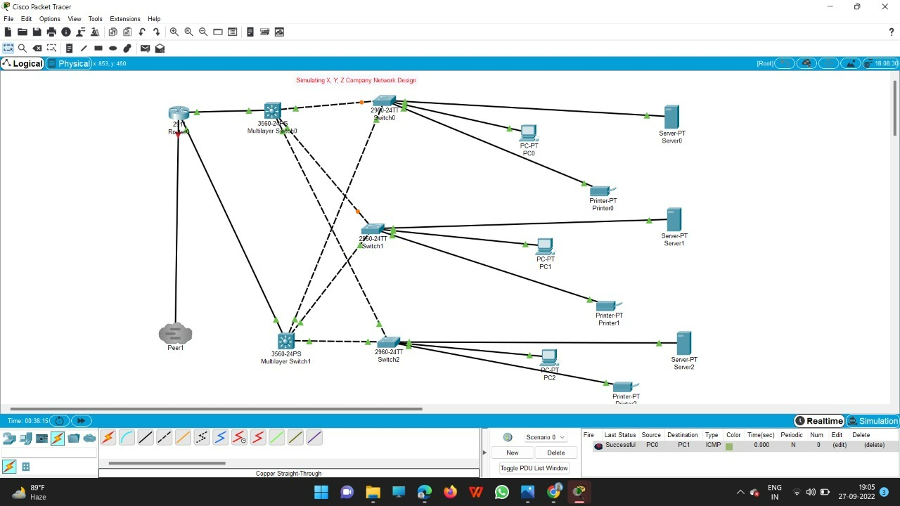
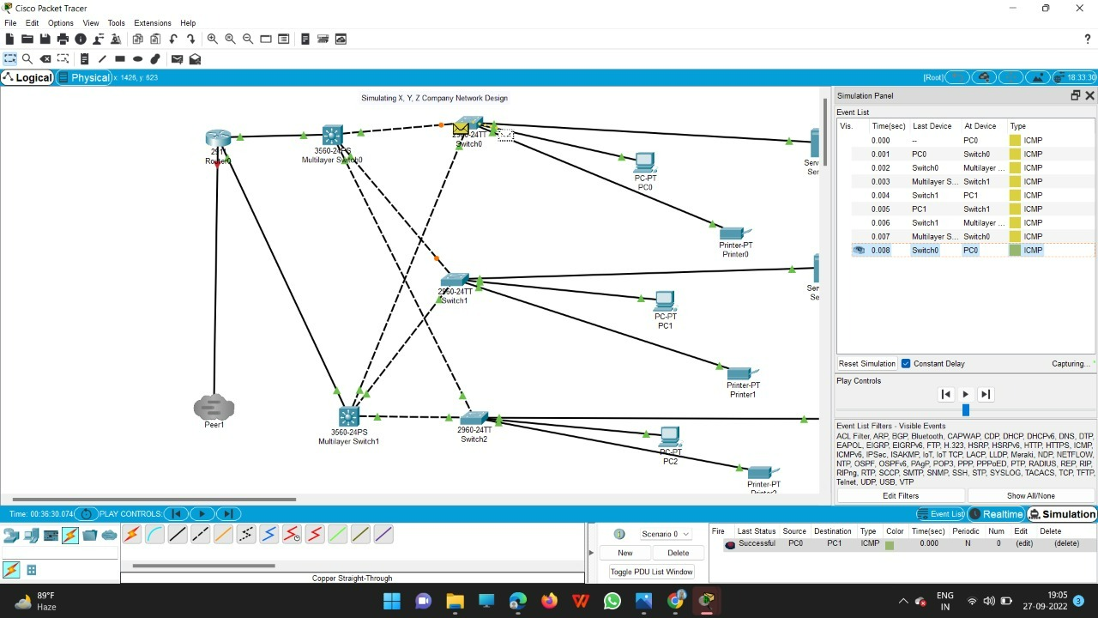

Slide 3
